Slide 1
Week 4
THE relational algebra Binary operation OF Division

Slide 2
Student Objectives
Upon completion of this video, you should be able to:
Identify the symbol for DIVISION
Given 2 tables and a DIVISION relational algebra expression, show the new table that would be returned once the expression is performed.
Write a relational algebra expression that uses DIVISION given two tables and a query.

Slide 3
DIVISION
R ÷ S returns a new table that contains:
For Columns: only the columns (i.e. attributes) that were in R that were NOT in S
For Rows: only the rows (i.e. tuples) from the remaining columns in R that match EVERY SINGLE row in S
The columns in S MUST be a subset of the columns in R.
R MUST have more columns than S
Division can be expressed as:
L1 ← π y (R)
L2 ← π y ((S x L1) - R)
L ← L1 – L2
Symbol → ÷
Example Expression:
Table1 ÷ Table2
Symbol for DIVISION
Second Table Name
First Table Name

Slide 4
Example of Division:
QUESTION: What will CC ← AA ÷ BB return?
Table AA:
Table BB:
A | B
a1 | b1
a2 | b1
a3 | b1
a4 | b1
a1 | b2
a3 | b2
a2 | b3
a3 | b3
a4 | b3
a1 | b4
a2 | b4
a3 | b4
A
a1
a2
a3
Table CC:
B
b1
b4

Slide 5
Another example
QUESTION: What will CC ← AA ÷ BB return?
Table AA:
Table BB:
A | B | C | D
dog | 2 | 77 | pink
dog | 3 | 77 | yellow
cat | 2 | 88 | pink
pig | 1 | 77 | yellow
pig | 5 | 99 | red
cat | 1 | 88 | yellow
owl | 1 | 66 | yellow
owl | 2 | 77 | pink
owl | 2 | 66 | pink
B | D
1 | yellow
2 | pink
Table CC:
A | C
cat | 88
owl | 66

Slide 6
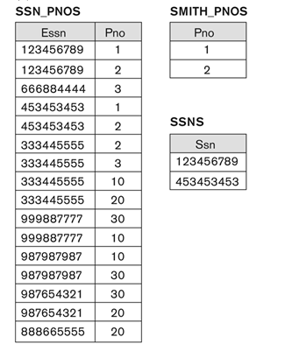
Type of query might be: Find SSN’s of people who work on all of Smith’s projects
Result of: SSN_PNOS ÷ SMITH_PNO

Slide 7
Useful for situations where the term "ALL" is used, for example:
Find the first and last names of employees who work on all the projects that Dave Leno works on.
the answer would be like this:
Leno ← π _{EmplD} (σ _{LastName = “Leno”} (Employee))
Leno_Proj ← π _{ProjectNumber} (Works_On ⋈ _{EmpIDSSNum = EmpID} Leno)
All_Proj ← π _{EmpIDSSNum, ProjectNumber}(Works_On)
LenoPROJ ← All_Proj ÷ Leno_Proj
Result ← π _{FirstName,LastName} (LenoPROJ ⋈ Employee)

Slide 8
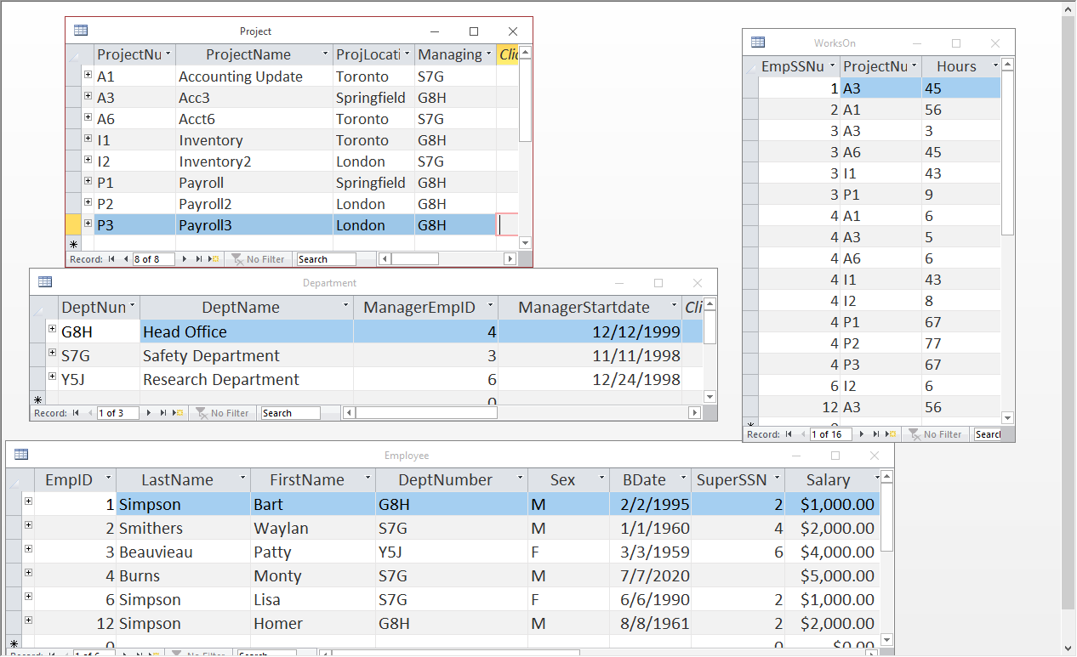
QUESTION: Write the relational algebra to find the project names of any projects that also have all the employees working on them that work on the project named “Acct6”.
Acct6 ← π_{ProjectNumber}(σ_{ProjectName=“Acct6”}(Project))
Acct6_Emp ← π_{EmpSSNum}(Works_On ⋈ Acct6)
ProjNums ← π_{EmpSSNum,ProjectNumber}(Works_On)
AllAcct6 ← ProjNums ÷ Acct6_Emp
Result ← π_{ProjectName} (AllAcct6 ⋈ Project)

